Slide 1

Open Source Software Development
Class: M02
Group 12:
Member:
Huỳnh Trần Tuấn Ngọc – B2005850
Nguyễn Phú Toàn – B2014953
Trần Đăng Khoa – B2014926
motphutcantho.com

Slide 2
Contributing to OpenQuotes: Add Your Favorite Quotes
GFI: https://github.com/MrAshwin2142/OpenQuotes/issues/38
My link repo: https://github.com/ngoc1230321/OpenQuotes

Slide 3
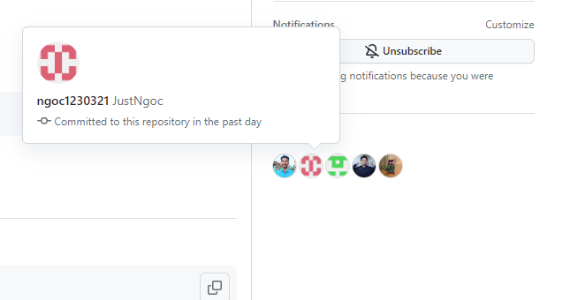
Add Assign

Slide 4
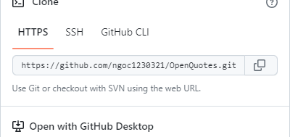
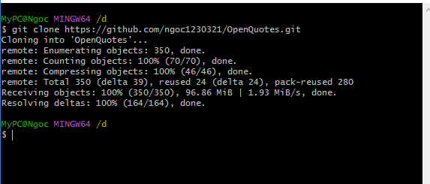
How to add your favorite quotes
Fork and clone the repository of GFI

Slide 5
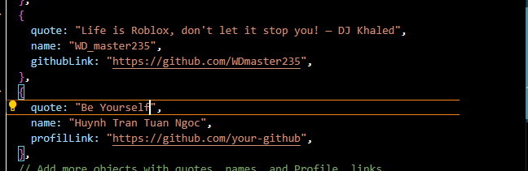
Add your quote

Slide 6
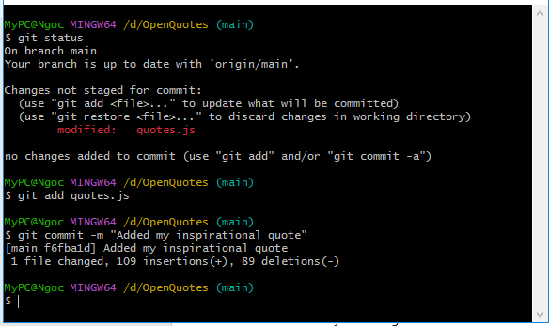
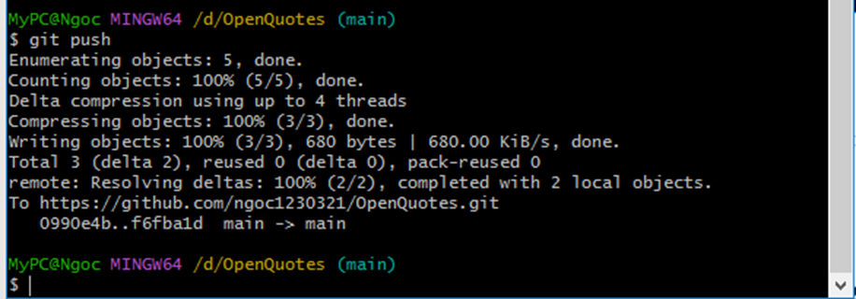
Commit and push your changes

Slide 7
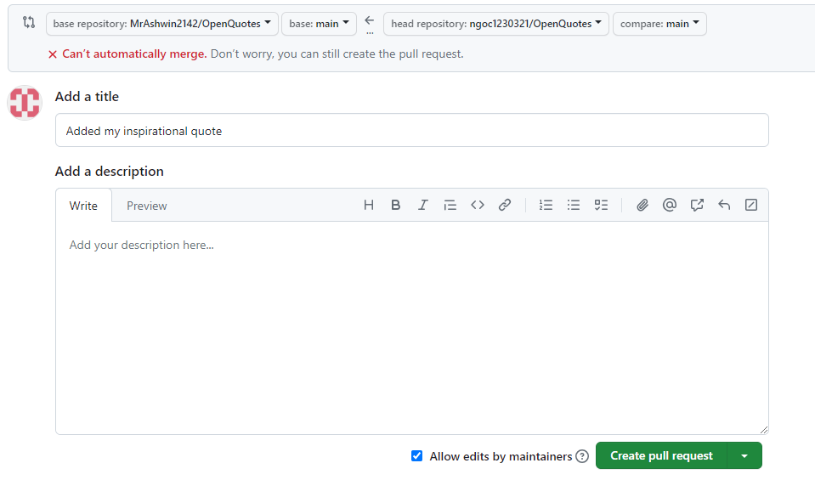
Create a Pull Request

Slide 8
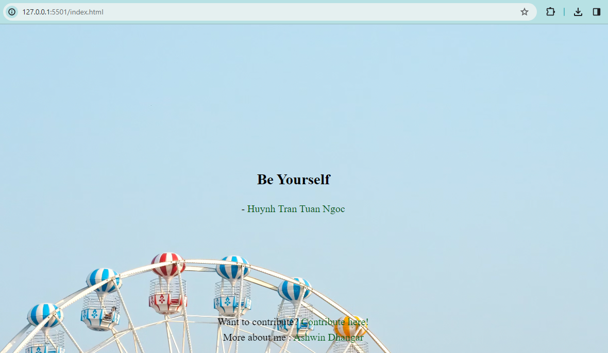
Result

Slide 9
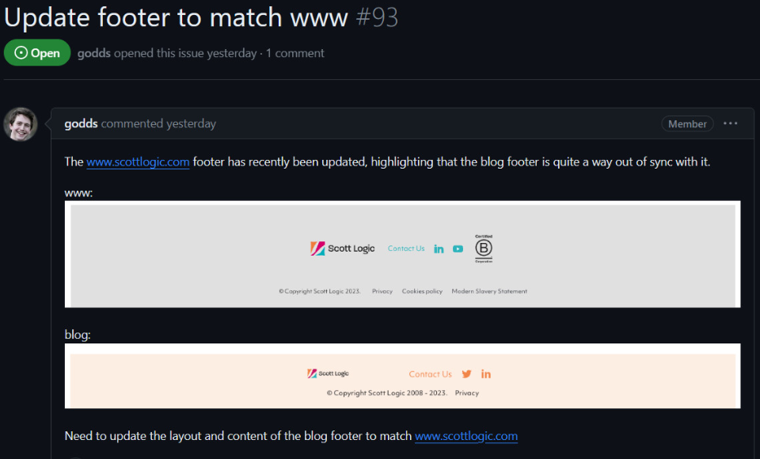
ISSUE:
Update footer to match www · Issue #93 · ScottLogic/blog (github.com)

Slide 10
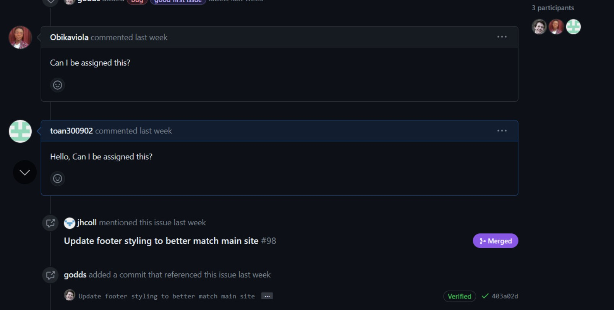
Add Assign:

Slide 11
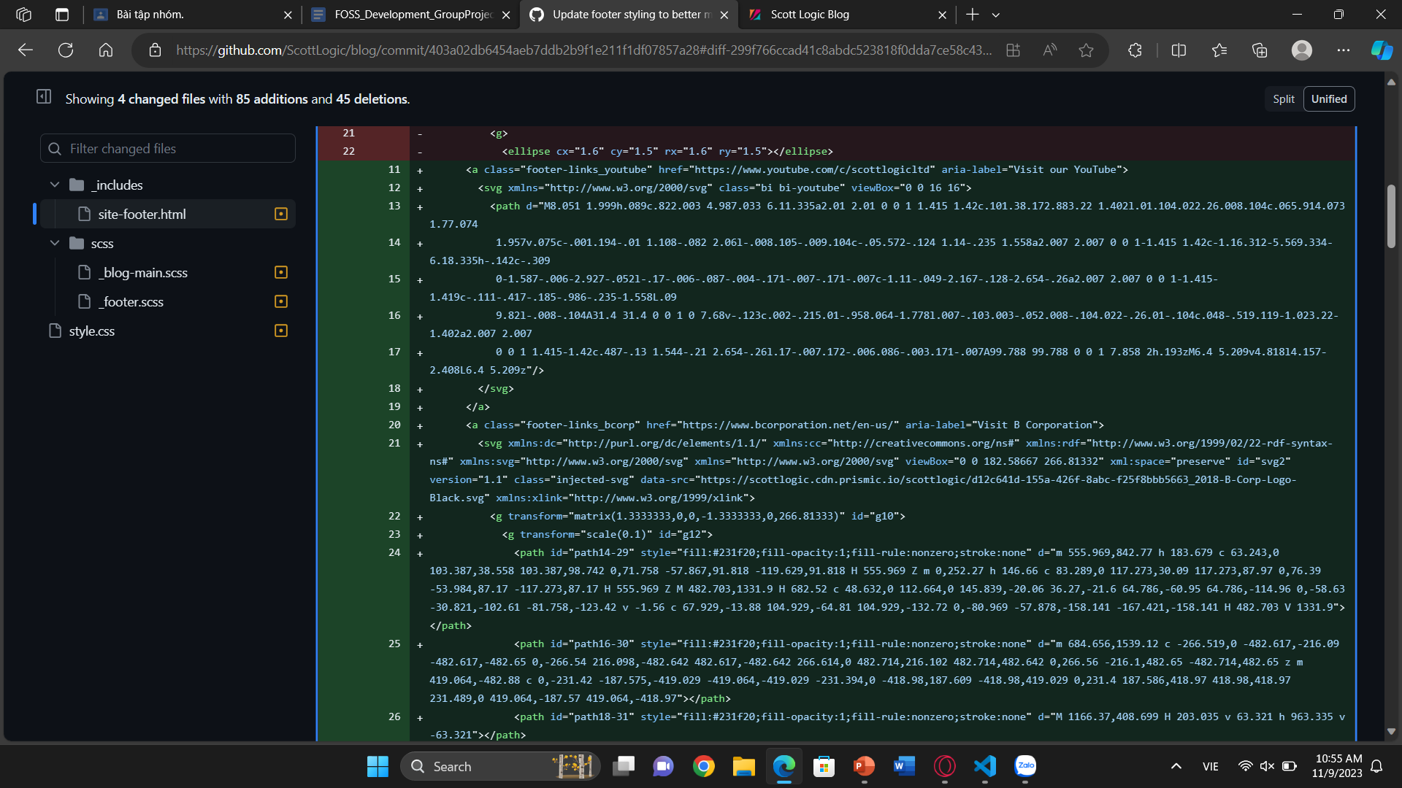
FIX BUG:
Use the same CSS used on the www page for the blog site to create design consistency.

Slide 12


Results after editing
www:
Blog (before):
Blog (after):

Slide 13
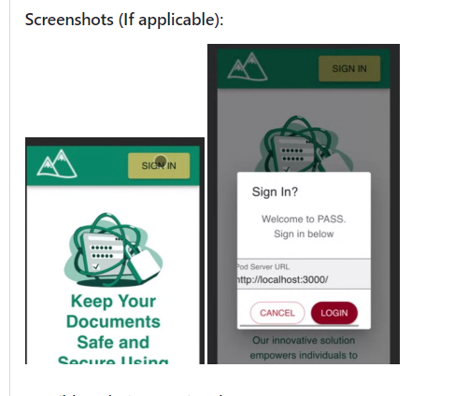
Bug: mobile "sign in" modal side scroll
Link Github: https://github.com/codeforpdx/PASS.git

Slide 14
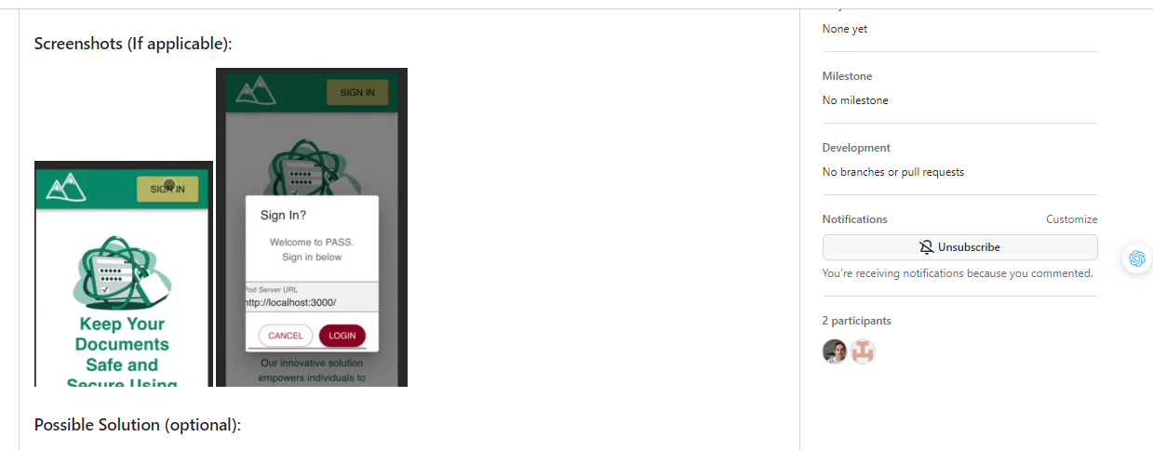
Add Assign:

Slide 15


FIX BUG:
before editing:
after editing:

Slide 16
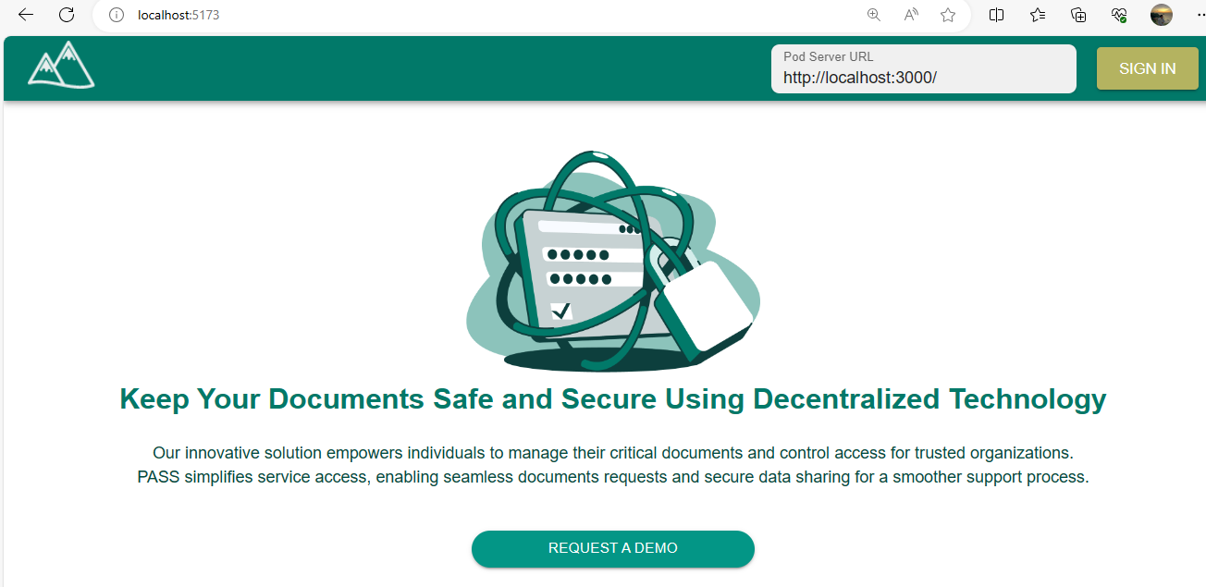
Results after editing

Slide 17
Good Bye
Thank for listening.
motphutcantho.com

